Slide 1
Hyperlinks
Links (or hyperlink, or Web link), the basic hypertext construct. The key feature which separates HTML (HypertextTML) from other conventional markup languages.
Linking a page to other content in a different location (within the same site or elsewhere on the internet) is fundamental.
The default behavior associated with a link is the retrieval of another Web resource.

Slide 2
Hyperlinks
A link has two ends -- called anchors -- and a direction.
The link starts at the "source" anchor and points to the "destination" anchor, which may be any Web resource (e.g., an image, a video clip, a sound bite, a program, an HTML document, an element within an HTML document, etc.).
We use an anchor tag <a> to link to another place. The href attribute tells the browser where to link to: <a href="https://www.google.com">Here’s a link to Google</a>

Slide 3
Navigating within same page.
We can have bookmarks with in a webpage
<!DOCTYPE html>
<html>
<body>
<p><a href="#js">Go to Javascript</a></p>
<h2 id=”js”>Javascript</h2>

Slide 4
Navigating to other page in your directory
<!DOCTYPE html>
<html>
<body>
<a>Contact</a>
<a href=”./otherfile.html">Coursework</a>
<a href="#news">Projects</a>
</body>
</html>

Slide 5
Creating a navbar
Just put all the the anchor tags in one div block, you will get a plain HTML nav bar with out any styles.
<!DOCTYPE html>
<html>
<body>
<div>
<a class="active" href="#home">Contact</a>
<a href=” other_page_in_your_directory.html">Coursework</a>
<a href="#news">Projects</a>
<a class="name" href=”other_page_in_your_directory.html">Your name</a>
</div>
</body>
</html>

Slide 6
Navigation-External website
Provide the URL to which you want to redirect.
<a href="https://www.google.com">Here’s a link to Google</a>

Slide 7
Navigation-conclusion
By specifying one extra attribute ”target”, We can specify where to open our new page.
Eg: <a href=https://www.google.com target=“_blank”>Here’s a link to Google</a>
By adding a title attribute, You can add a tooltip text which gives extra information when you hover the mouse on to that link.
Eg: <a href=https://www.google.com target=“_blank” title=“Open Google search”>Here’s a link to Google</a>

Slide 8
Inserting images
<img src="myimage1.jpg">
<img src="subfolder/anotherimage.gif">
Images can be in folders.
Widely-supported image formats
gif (good for logos)
jpg (good for photos)
png (general-purpose)

Slide 9
Inserting other pages (IFRAME)
Blah blah blah
<iframe src="otherpage.htm"></iframe>
bottom of my page

Slide 10
Inserting videos
<video width="400" height="300" controls>
<source src="http://blahblah.com/videofile.mp4"
type='video/mp4; codecs="avc1.42E01E, mp4a.40.2"'>
<source src="http://blahblah.com/videofile.ogv"
type='video/ogg; codecs="theora, vorbis"'>
</video>
This is the standard HTML version 5 way of inserting videos. Older browsers do not support this tag, FYI. You need to create both mp4 and ogv formats to insert videos this way.

Slide 11
FYI about videos
A video file is like a zip file or a package file
It essentially has several streams or files "inside" it
Some of the streams are for video, others for audio
Each of these is encoded and/or compressed
The encoding/compression algorithm is called a codec
There are lots of possible codecs
Your browser reads, decodes, expands, plays all of these streams in parallel
Assuming the codecs are installed on your computer and properly configured for your browser!

Slide 12
Much simpler approach
Post the video to YouTube or Vimeo
Let their server figure out how to convert
Use "share" and "embed" to get HTML
These instructions may not sound sophisticated, but they will enable you to "keep up with the times" as new standards come along!

Slide 13
Example of HTML to embed video
<iframe width="420" height="315" src="http://www.youtube.com/embed/YwlVgpXXJS0" frameborder="0" allowfullscreen></iframe>
Basically, you're putting a little YouTube page inside your own.
Note: You have to put /embed before the hash of the video.
You might not be able to play some times because of domain restrictions.

Slide 14
The Document Object Model (DOM)
The Document Object Model, or DOM, is a representation of an entire HTML page as a tree structure. It is also an API for interacting with that HTML page.
The DOM is the representation of HTML stored in memory after parsing.

Slide 15
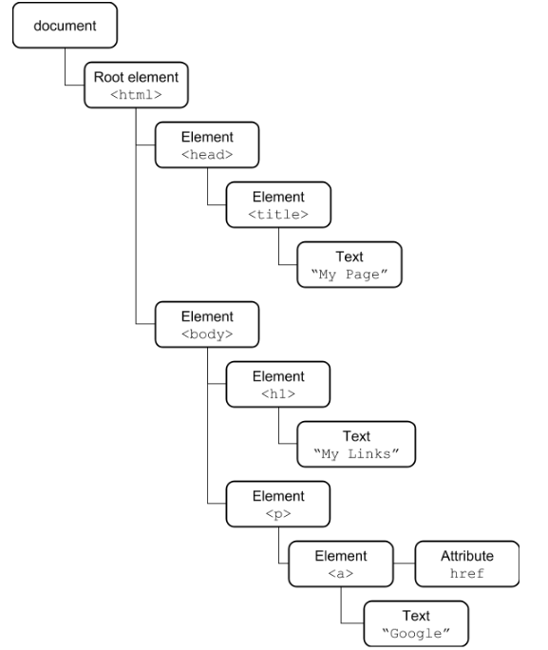
The Document Object Model (DOM)
Here is one sample HTML and its DOM.
<html> <head> <title>My Page</title> </head> <body> <h1>My Links</h1> <p> <a href=”http://google.com”>Google</a> </p> </body> </html>

Slide 16
HEAD versus BODY
Sometimes you want to put invisible stuff on the page that gets loaded before the visible stuff
Examples: style information, scripts, etc
This goes in the HEAD
Everything else goes in the BODY

Slide 17
HEAD vs BODY example
<html><head><title>My page title</title>
</head><body>
<h1>Visible content starts here</h1>
And <em>fine</em> content it is, too!
</body></html>

Slide 18
Activity
Post a web page that has the following:
A <head> containing a <title> with your name
A <body> containing a <main> containing a <p> containing one sentence describing what you want to do after you graduate

Slide 19
Handy tags for organizing content
<main>…</main> for your main content
Usually contains some sections
<section>…</section> for a section
Omit if there's really just one section
Usually contains several <p> or <div> tags, maybe a low-level heading such as <h3>
<nav>…</nav> for navigation
Usually contains a list of links

